Slide 1
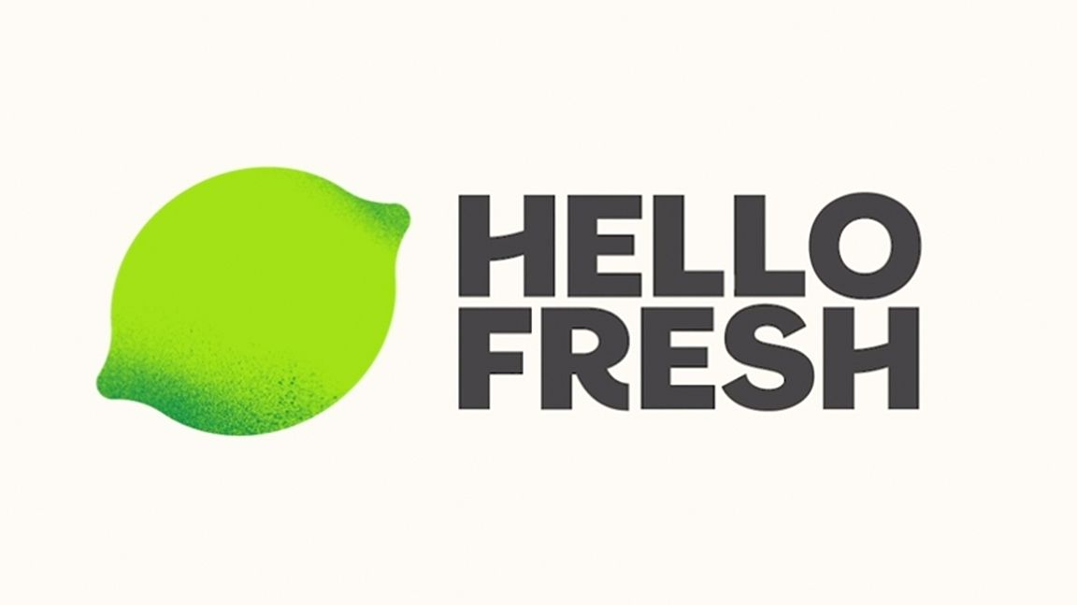
Project Director: Ella
Account Director: Amina
Media Director: Kiersten
Creative Director: Caroline

Slide 2
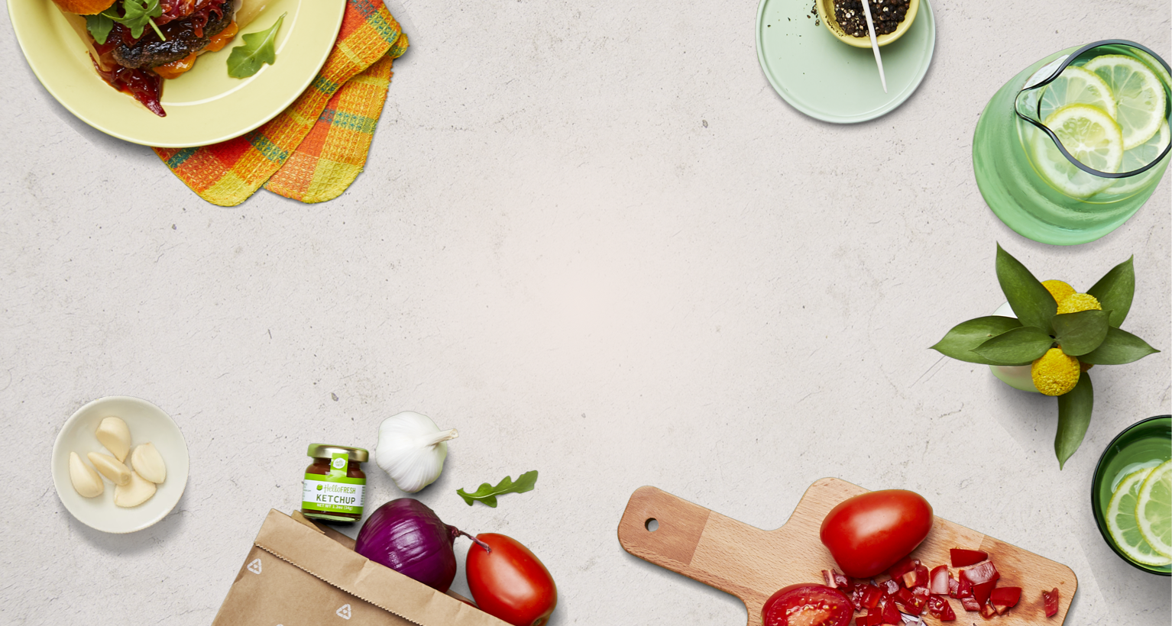
Account Planning

Slide 3

Background
About HelloFresh:
A subscription meal delivery service providing customers with easy to follow recipes and fresh high-quality ingredients
German company founded in 2011 by Dominick Richter, Thomas Geisel, and Jessica Nelson in Germany
Expanded to U.S. in 2012, currently operating in 14 countries
Largest meal-kit player in the market globally
Competitors:
Blue Apron
DoorDash
Instacart
Sun Basket
Green Chef
Home Chef
Products/Services
Food ingredients
Meal delivery
Recipes
Social Media Following:
Instagram-607k
Twitter-43.4k
Linkedin-282k
TikTok-23.5K
Facebook-2.4M
Current Market Share:
69% of the U.S meal kit market
Owns Green Chef, EveryPlate, Chef’s Plate
Existing Target Market:
Women ages 30-50

Slide 4
SWOT Analysis
Strengths: Strong product Customer satisfaction Focus on sustainability Strong financial performance Great Distribution Network Influencer marketing | Weaknesses: Costly service and product Limited differentiation from competitors’ product Damage & wastage
Opportunities: Post-Covid increase in delivery Changing customer behaviors Innovation | Threats: Competition Low obstacles to enter

Slide 5
Our Campaign

Slide 6
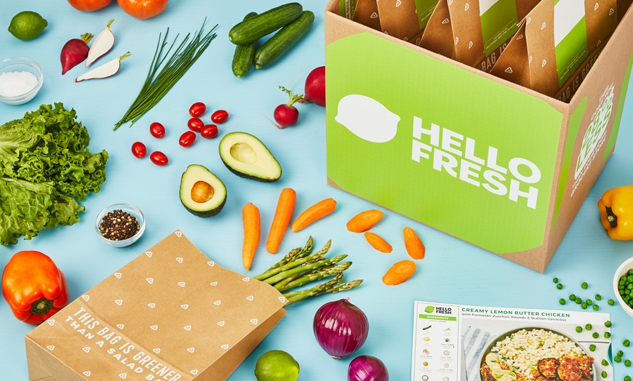
Goal
Increase customer base of consumers ages 18-24 by 20%.
Objective #1
Build awareness of our brand’s attributes that cater to our target market.
Objective #2
Increase website traffic of users 18-24 by 30%.

Slide 7
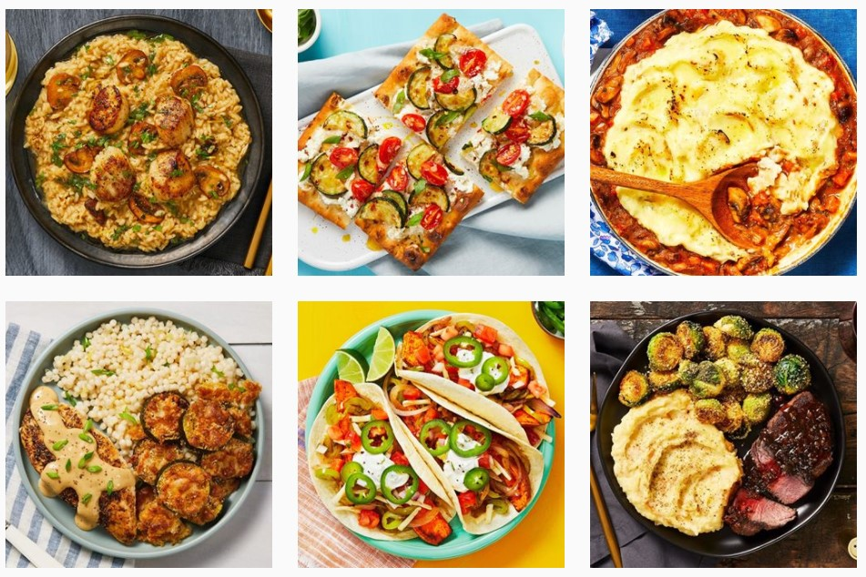
Product/Service Statement
HelloFresh is a meal service for those on the go: the beginners, the foodies, the health nuts, and anyone looking for quality ingredients delivered right to their doorstep. Our fresh, pre-measured ingredients and easy-to-follow recipes provide a hassle-free experience in the kitchen and guaranteed satisfaction. Our commitment to sustainability aims to ensure both our customers and our planet are living better.

Slide 8

Campaign Target Audience
18-24
College student
From Mid-income level family / has some sort of disposable income
Geographic location: Areas with large universities
Health-conscious

Slide 9

Personas
Luke is a pre-med college student who spends all of his time studying, tutoring, or at his part-time job. Because of his packed schedule, he consistently orders take-out and rarely goes grocery shopping. Because HelloFresh meals take less than 30 minutes to make, Luke could spend the money he’s using on unhealthy take-out and sign up for this subscription service to eat better meals without spending his valuable time grocery shopping, prepping, and cooking dinner.

Slide 10

Personas
Karla is a freshman who lives off campus and did not sign up for a dining hall plan. As it is her first year living on her own, she has very little experience cooking, often making ramen noodles or frozen pizza as she’s intimidated by the grocery store and doesn’t know where to start. Hello Fresh would provide her with the right means to introduce her to cooking with step by step instructions and pre-measured ingredients for her to make quality meals without the hassle and stress of grocery shopping.

Slide 11

Personas
Max is a student-athlete who prioritizes health but struggles to find the time to make healthy meals every week with his hectic athletic and school schedules. HelloFresh would provide him with both quick and healthy meals to accommodate his lifestyle.

Slide 12
Media Planning

Slide 13
Media Planning-Traditional
Mail
  Research shows Gen Z finds traditional mail to be a refreshing break from always-on digital ads, a welcome form of nostalgia, and a more personal advertising experience.
Flyers
  Will include information about the company and prove a QR code for first timers.
*HelloFresh currently offers 65% off on your first box and free shipping

Slide 14
Media Planning-Digital
Tiktok
  The majority of the TikTok audience is Gen Z, with 42% of the audience aged 18 to 24 years old.
Instagram
  Instagram still dominates the 18-34 crowd with it representing 61 percent of its user base.

Slide 15
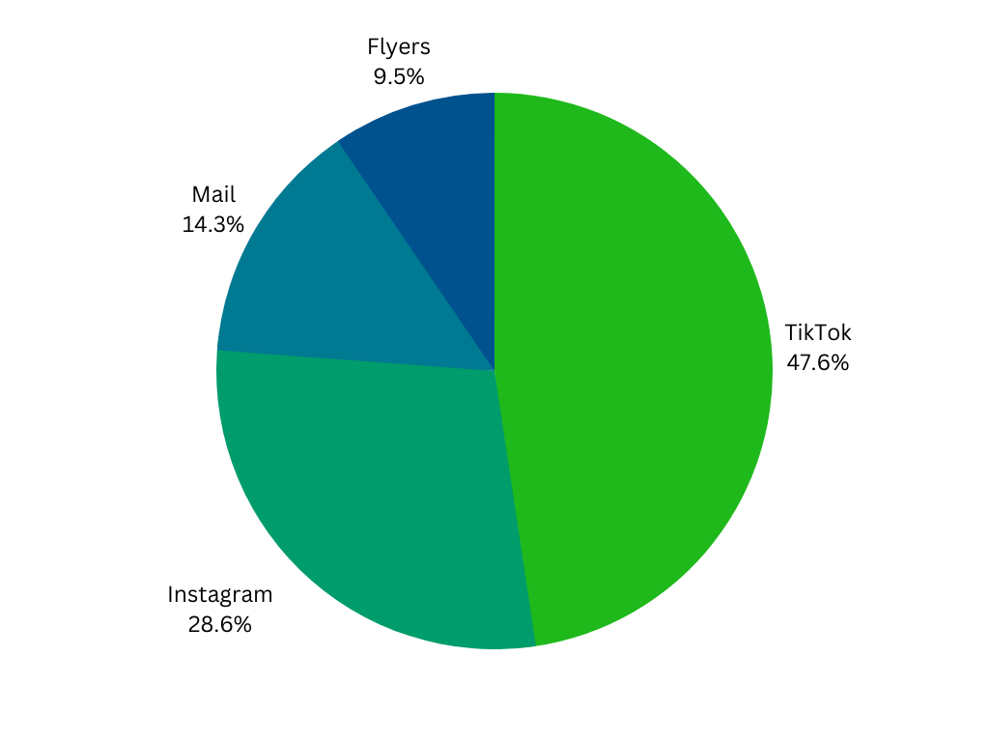
Budget Allocation
Larger push for digital media since it will lead to more visits to the website.
TikTok costs more than Instagram for CPM at $10 vs $6.70 plus has a $500 so it will receive more of the budget.
Direct will cost roughly $1500 per 1000 units
Flyers will cost roughly $500 per 1000 units.

Slide 16
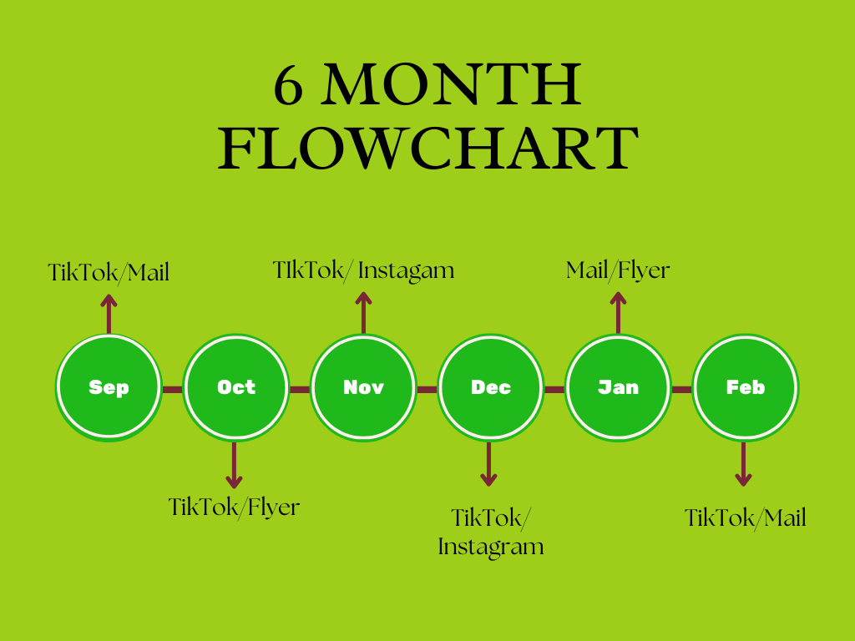
6 Month Timeline
Sept- Tiktok/mail to get the buzz going
Oct-Tik Tok/flyers to get the promo/discount going
Nov-TikTok/Instagram (thanksgiving break)
Dec-TikTok/Instagram (winter break)
Jan- Mail/Flyer remind them of a home cooked meals they just had at mom
Feb-TikTok/instagram (ideas for Valentine’s day)

Slide 17
Advertising Execution

Slide 18
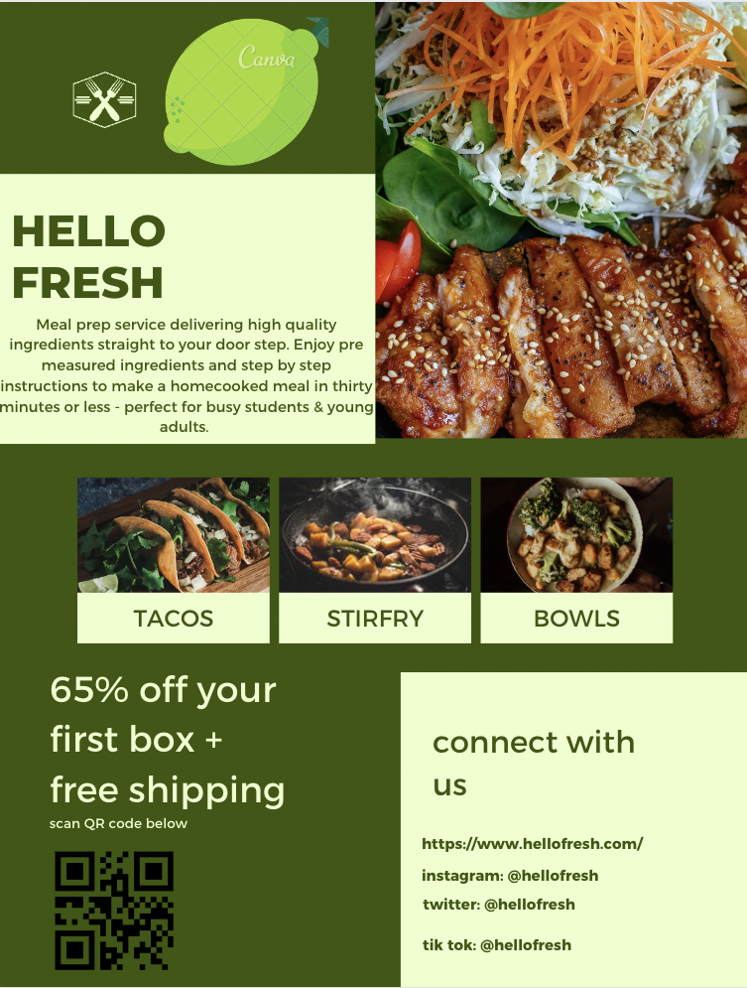
Creative Piece #1 - FLYER (Traditional Media)
RATIONALE:
Font, colors, and images used create an appealing and engaging presentation that will attract audience
Images of familiar foods will create feelings of excitement
Easily accessible QR code right on the flyer to guide audience to the website/to the 65% off offer
Flyers will be circulated in student centers and posted on various bulletin boards in businesses throughout the college towns/cities to reach as many students and young adults as possible
KPI: measure impressions from amount of website traffic based on QR code scans

Slide 19
Creative Piece #2 - Tik Tok Ad (Digital Media)
https://www.canva.com/design/DAFRh4GquxU/3OnKwNHGjvUYPFp_TXgwkg/watch?utm_content=DAFRh4GquxU&utm_campaign=designshare&utm_medium=link&utm_source=publishsharelink
Rationale:
Visually engaging, on theme with the brand’s green fonts and themes
Recipes of familiar classics shown such as pancakes and soup
Young adults coming together to make a meal will spark a feeling of accomplishment and community
Visual breakdown of the straightforward concept of Hello Fresh
Minimal text used on last slide to promote the brand and the 65% off offer - will be able to swipe up on the screen to be connected to the website
KPI: measure impressions from amount of new tik tok followers and also website traffic from the ad

Slide 20
References
https://iide.co/case-studies/swot-analysis-of-hellofresh/https://www.bstrategyinsights.com/hellofresh-swot-analysis/https://www.extole.com/blog/how-hellofresh-marketing-strategy-made-them-the-top-us-meal-kit/
https://seekingalpha.com/article/4511808-hellofresh-the-meal-kit-company-that-delivers
https://boersengefluester.de/wp-content/uploads/assets/annuals/2015/A16140.pdf
https://www.business.com/articles/nicholas-brown-generation-z-and-the-future-of-print-marketing/
https://www.brandunited.com/article/direct-mail-millennials-vs-generation-z/
https://www.hellofresh.com/plans
https://blog.hootsuite.com/what-is-tiktok/
https://www.caylor-solutions.com/social-media-trends-2022/
https://www.webfx.com/social-media/pricing/how-much-does-it-cost-to-advertise-on-instagram/
https://www.businessofapps.com/marketplace/tiktok/research/tiktok-ads-cost/
https://www.postgrid.com/direct-mail-marketing-costs/

